Slide 1
Azure Security Posture

Slide 2
Agenda
A Modern Enterprise
Challenges Faced
Need for Azure Governance
The Governance Scaffolding
Understand the Security Landscape
Components of Azure Security Model
Unified Security Management - Azure Security Center
Unified Visibility
Advanced Threat Prevention
Intelligent Detection & Response
Security Implementation Process

Slide 3
Azure Security Center
Governance Implementation

Slide 4
A TRUSTED CLOUD PLATFORM
THAT EMPOWERS CUSTOMERS
Key Vault
Virtual Networks
Network Security Groups
VPN + ExpressRoute
Azure Active Directory
Marketplace Solutions
Azure Security Center
Security
Privacy and Control
Transparency
Compliance

Slide 5

Azure Security Center helps unlock cloud opportunities
Gain visibility and control
Enable security at cloud speed
Keep up with cyber threats

Slide 6
Distributed security responsibilities
Ellen
CISO/CIO
Jeff
Cloud Workload Owner
Manages a cloud workload and its related resources (often in a DevOps role)
Responsible for all aspects of security for the company
David
IT Security
Sets company security policies and ensures compliance
Judy Security Ops
Monitors and responds to security alerts 24/7
Sam
Security Analyst
Investigates attacks

Slide 7
Microsoft Azure Security Center
Unify security management and enable advanced threat protection for hybrid cloud workloads
Unified visibility and control
Adaptive threat prevention
Intelligent detection and response

Slide 8










Architecture
THREAT
INTELLIGENCE
AZURE
NETWORK & PAAS Netflow, SQL DB and Storage Logs, …
AZURE SECURITY CENTER
SECURITY ANALYTICS
Threat Detections, Prescriptive Recommendations
Security Dashboards Deliver Rapid Insights into Security State Across All Workloads
Security Dashboards Deliver Rapid Insights into Security State Across All Workloads
WINDOWS & LINUX AGENTS
Windows Events, Syslog, CEF (Common Event Format), Configurations
Actionable Security Recommendations
NORMALIZATION & ENRICHMENT IP Geotagging, …
SCALABLE LOG ANALYTICS
PLATFORM
Curated, Prioritized Security Alerts
ON-PREMISES, PRIVATE AND PUBLIC CLOUDS
Investigation Tools and Log Search
Export to Excel and Power BI
API
REST APIs
Automation
Notifications

Slide 9
Unified Visibility
Azure Security Center

Slide 10
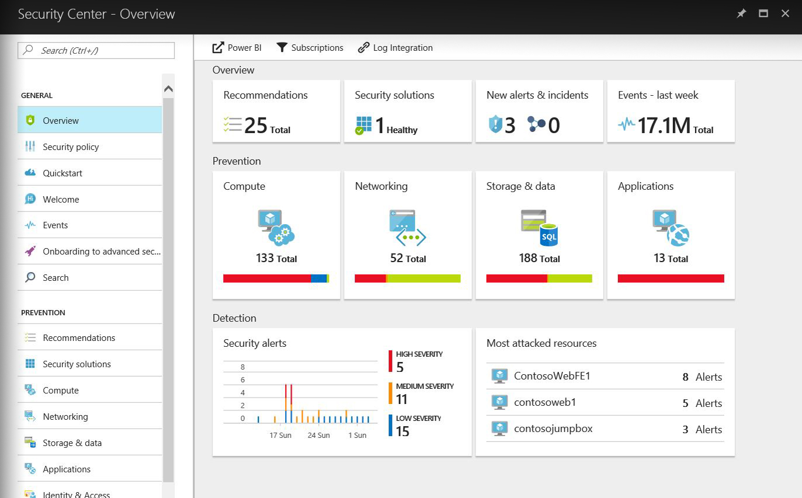
Understand security state across hybrid workloads
Built-in Azure, no setup required
Automatically discover and monitor security of Azure resources
Gain insights for hybrid resources
Easily onboard resources running in other clouds and on-premises

Slide 11
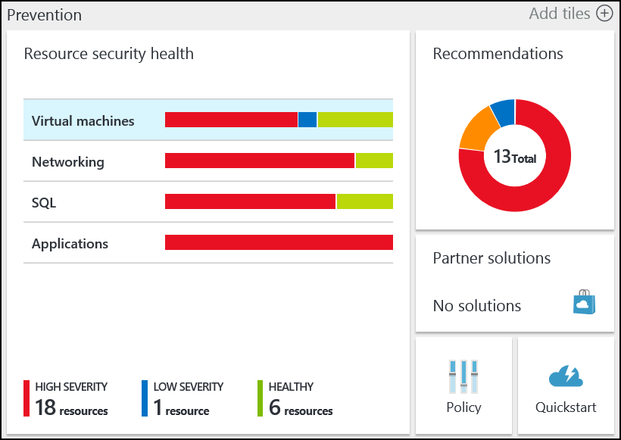
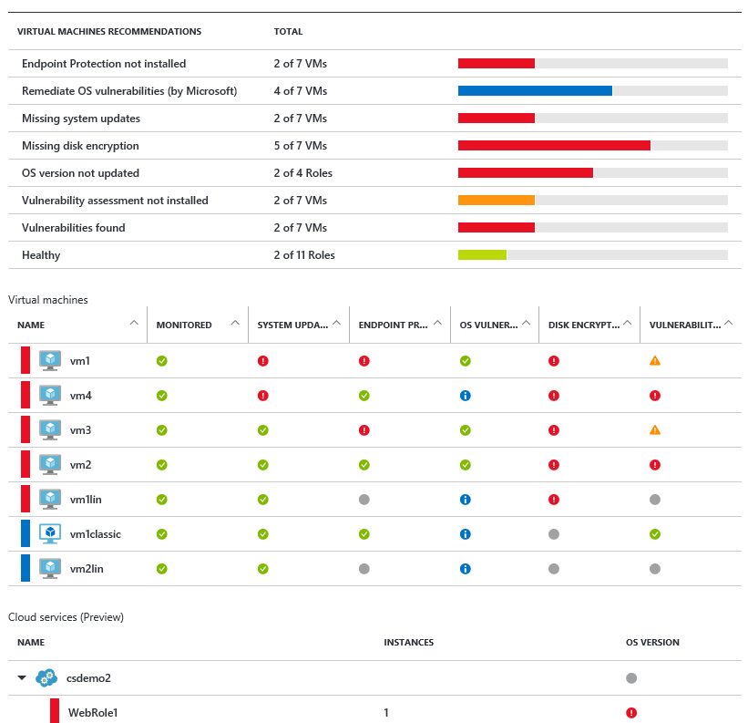
Monitor the security state of resources – quickly identify vulnerabilities

Slide 12
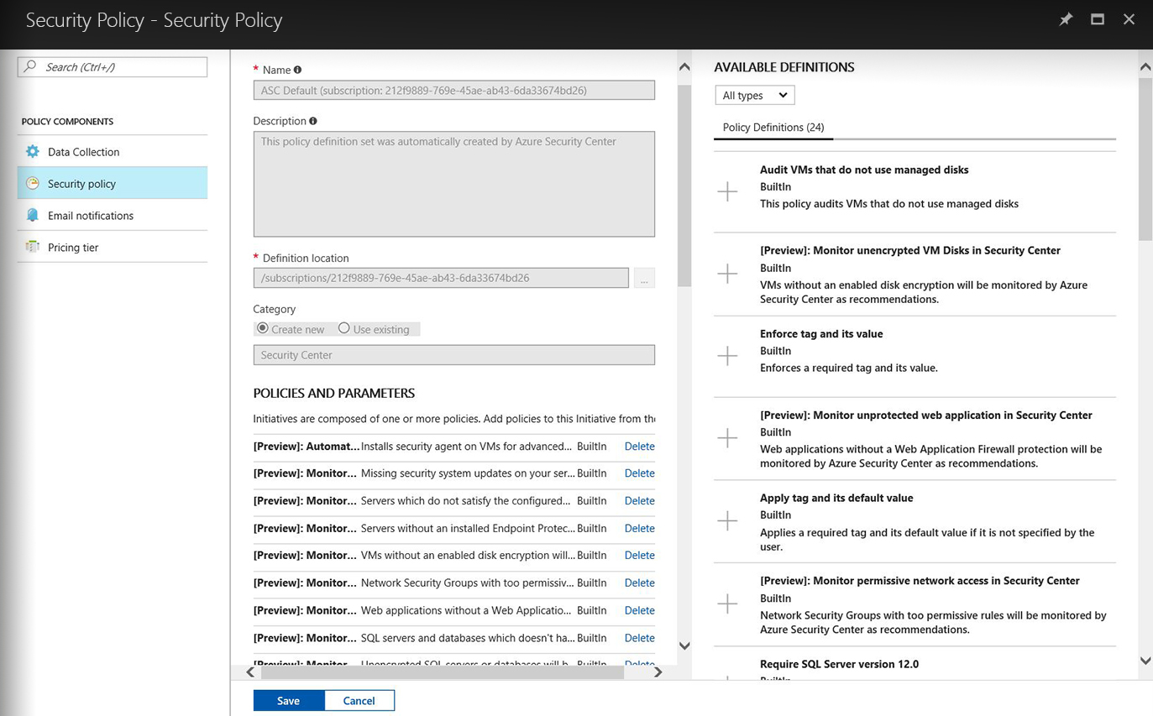
Ensure compliance with policy management
Central policy management
Define a security policy for each subscription in Security Center
Apply across multiple subscriptions using Azure Management Groups

Slide 13
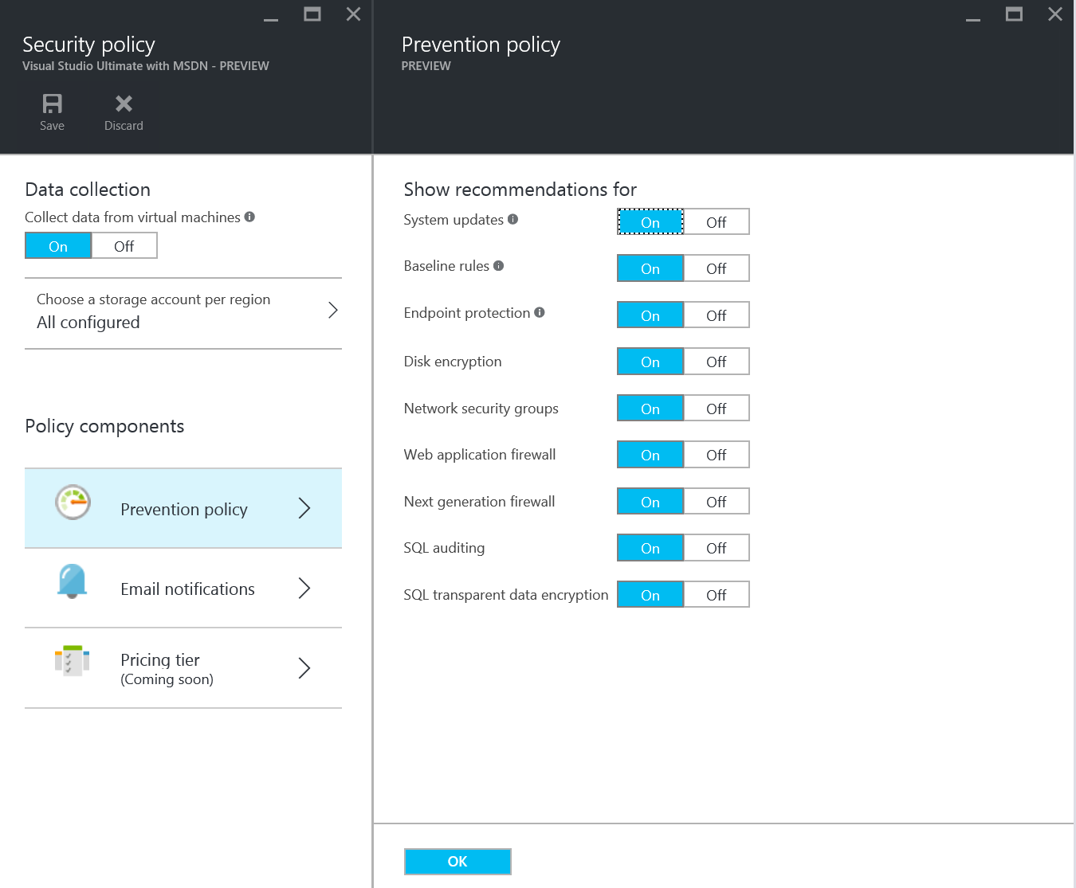
Set security policies for subscriptions and resource groups

Slide 14
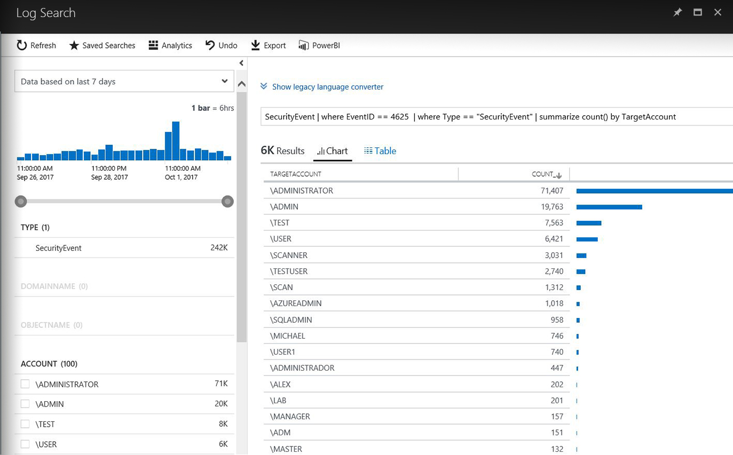
Gain deeper insights with integrated log analytics
Quickly identify list of notable events that require your attention
Out of the box notable events in dashboard or create custom queries
Search and analyze security data using a flexible query language
Use built-in or custom queries with Log Analytics search

Slide 15
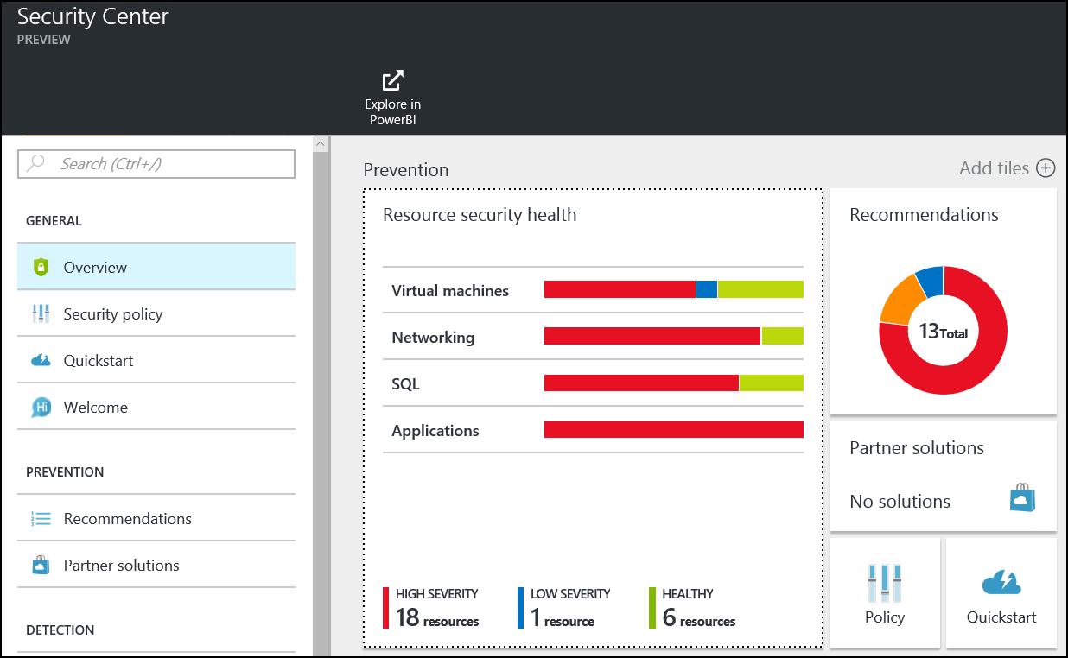
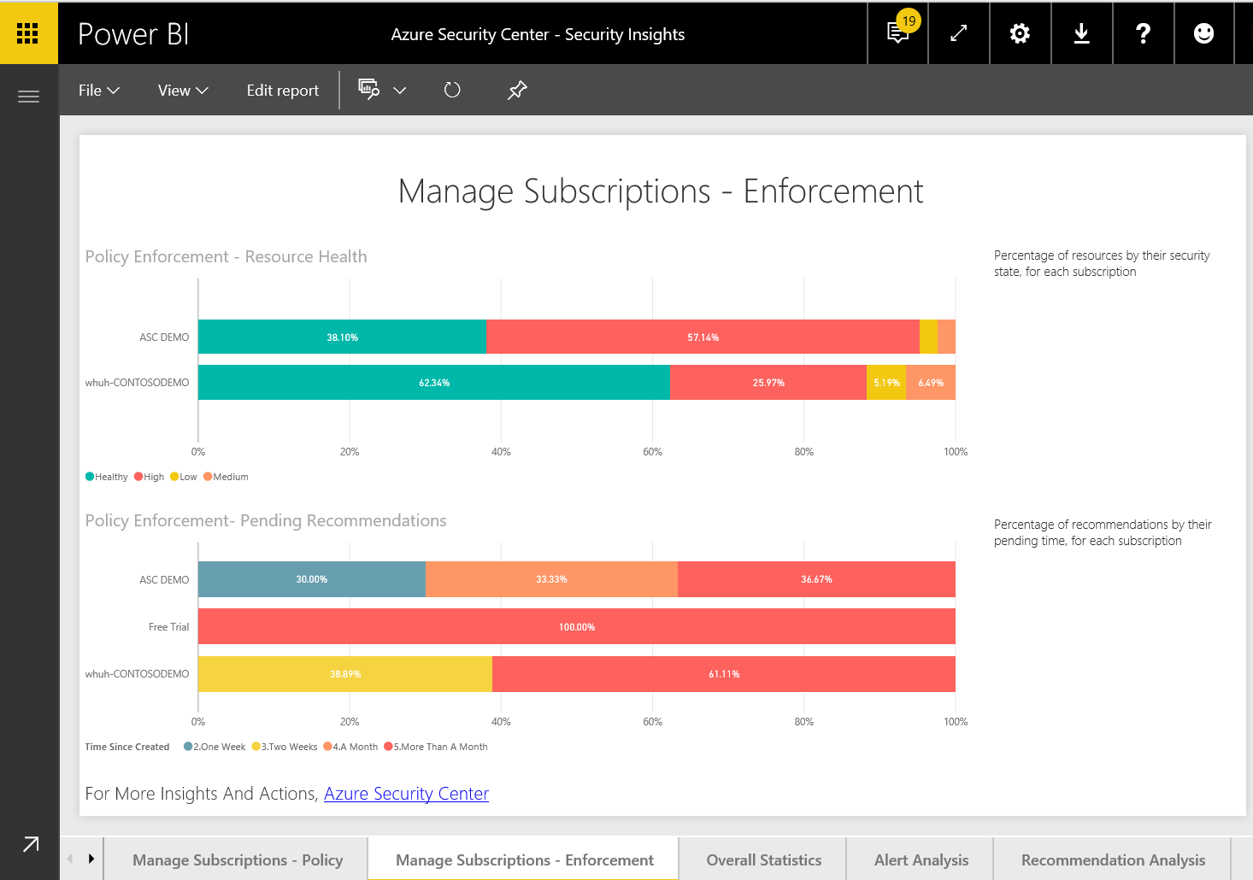
Gain insight into the security state of subscriptions in Power BI

Slide 16
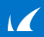

Access security data in near real-time from your Security Information and Event Management (SIEM)
Azure
Partners
WAF
DDoS
Azure Storage
Azure
Diagnostics
Azure APIs
Azure Log Integration
Log Analytics/SIEM
Rehydrate:
“Forwarded Events”
Flat files (IIS Logs)
CEF formatted logs
Export Logs
Standard Log Connector
(ArcSigt, Splunk, etc)

Slide 17
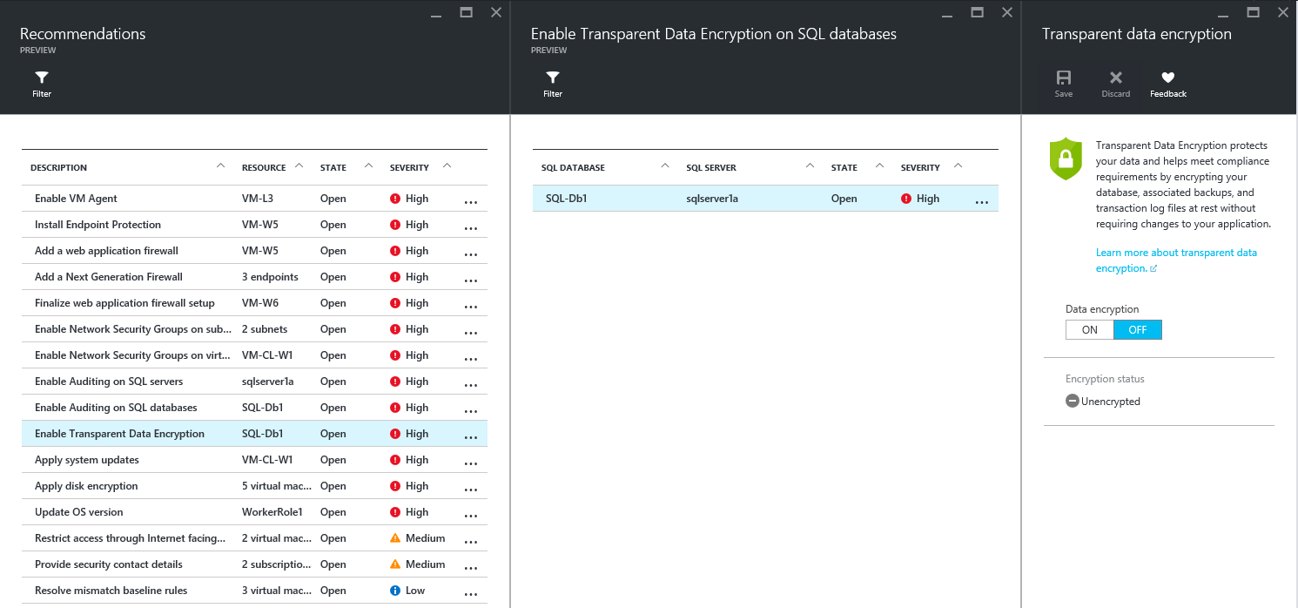
Prioritized recommendations take the guesswork out of security for resource owners

Slide 18
Analyze security information from variety of sources
Integrated partners
Connected security solutions running in Azure, e.g. firewalls and antimalware solutions
Microsoft security
Azure Active Directory Information Protection
Advanced Threat Analytics
Many others
Any security solution that supports Common Event Format (CEF)

Slide 19








Integrate partner solutions
Recommends and streamlines provisioning of partner solutions
Integrates signals for centralized alerting and advanced detection, including fusion
Leverages Azure Marketplace for commerce and billing
Closes security gaps created by disconnected point solutions

